Slide 1
Price Discrimination
11
Notes:
Pre-class music: “Rock Island Line” by Johnny Cash (See Tip #387)
This song is a good introduction to price discrimination, as it discusses the different tolls charged for goods transported in New Orleans.

Slide 2
Previously
While competitive markets generally promote social welfare, monopolies often do the opposite.
Perfectly competitive markets and monopolies are market structures at opposite extremes.
Like perfectly competitive firms, a monopoly tries to maximize its profits.
From an efficiency standpoint, the monopolist charges too much and produces too little. There is a deadweight loss.

Slide 3
Economics in Ally Bank Commercial, “Would You Like a Pony?”
“Even kids know it is not right to hold out on someone.”
Notes:
“Economics in the Media” Slide
Lecture tip:
The clip mentioned on the slide can be found in the Interactive Instructor’s Guide. Access the direct link by clicking the icon in the PowerPoint above.
You can follow up this clip by asking students:
How does Ally Bank discriminate among its customers?

Slide 4
Economics in It’s Always Sunny in Philadelphia, “Underage Drinking: A National Concern”
The normally vacant and unprofitable bar is suddenly overrun with underage drinkers.
Notes:
“Economics in the Media” Slide
Lecture tip:
The clip mentioned on the slide can be found in the Interactive Instructor’s Guide. Access the direct link by clicking the icon in the PowerPoint above.
The key concepts covered in this clip are:
Pricing
Profit
Inelastic demand
Incentives
Business ethics
Monopoly
Price discrimination
Showing this clip is a good way to start a discussion on inelastic demand, incentives, short-run profits, and price discrimination.

Slide 5
Big Questions
What is price discrimination?
How is price discrimination practiced?

Slide 6
What Is Price Discrimination?
Price discrimination
  Occurs when a firm sells the same good or service at different prices to different groups of customers, but . . .
  the difference in price is not related to costs.
Price discrimination is beneficial since it can allow markets to work more efficiently.
Is it legal?
Notes:
Lecture tip:
Point out that the word “discrimination” is not meant to be pejorative, as in “racial discrimination” or “gender discrimination.”
Make sure to emphasize the point about differences in costs.
Price discrimination is beneficial (it increases social welfare), since it allows more consumers to purchase the good or service.
On legality:
Generally, yes.
You could follow up answering the question of legality by discussing the Clayton Act and Robinson Patman Act.
Price discrimination is illegal if there is intent to harm rivals.
A more advanced example:
If you follow the cost argument, if a service is sold at the same price to two different customers, but the costs of serving them is different, it is another form of price discrimination.
Simple example: a haircut at Hair Cuttery.
The price of a basic haircut and shampoo is the same regardless of sex.
The time to cut a “typical” woman’s hair is more than that for a “typical” man’s hair.

Slide 7
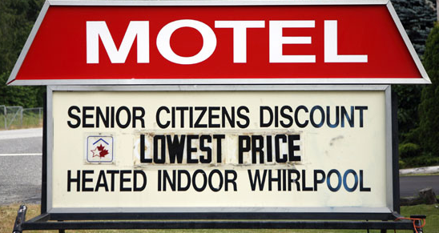

Examples of Price Discrimination
College tuition
Airline tickets
Prices of a movie at a theater
Hard cover vs. paperback book
Textbooks: U.S. edition vs. international edition
Selected “discounts”
Notes:
Lecture tip:
Click through the slide to reveal each example.
As you reveal each example:
Ask students in what way are these examples of price discrimination:
Who pays the higher/lower price?
How does the seller know which consumer to charge the higher/lower price?
Some additional points to make:
Hard cover versus paperback: intertemporal price discrimination
Textbooks: books are not exactly the same. International versions, which sell at a lower price, tend to have lower quality (not as many colors, cheaper paper).
Real-world example: Student Resells Cheaper Foreign Textbooks and Gets Sued for Copyright Infringement (See Tip #417)
This example is of a court case of a student who is being sued for buying textbooks at the low international price and reselling them domestically. Ask students when this strategy is profitable for the student (ignoring being sued).

Slide 8
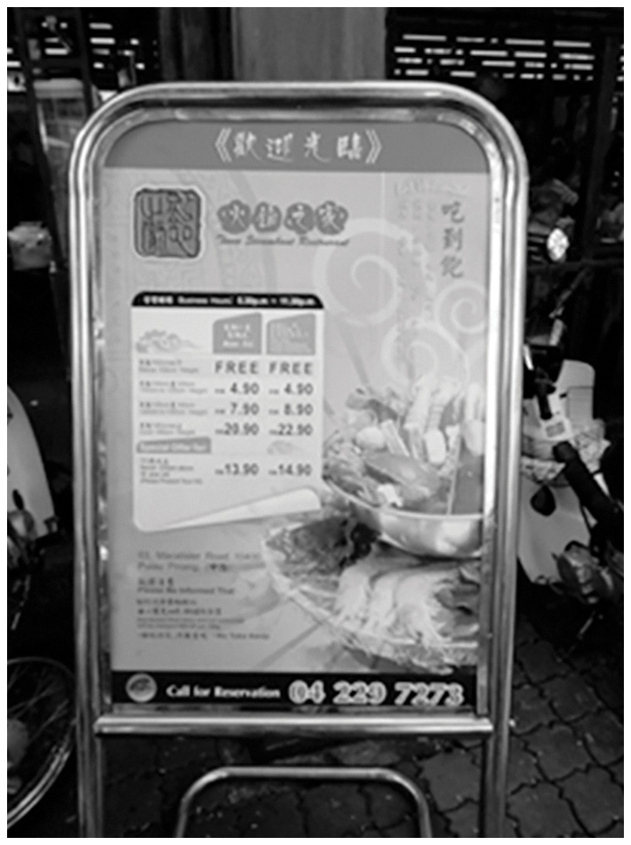
A Strange Example of Price Discrimination
A restaurant in Penang, Malaysia, sets prices segmented according to height, with a discount for the elderly.
Notes:
Real-world example: Price Discrimination Based on Height (See Tip #393)
A discount for the elderly makes sense, but ask students why they think prices are segmented according to height.
The Ultimate Guide suggests that it is a tax on Western foreigners, who tend to be taller than locals.
Ask students whether there is a simpler explanation:
What if the price was for an all-you-can-eat buffet?\
[Wayne Geerling]

Slide 9
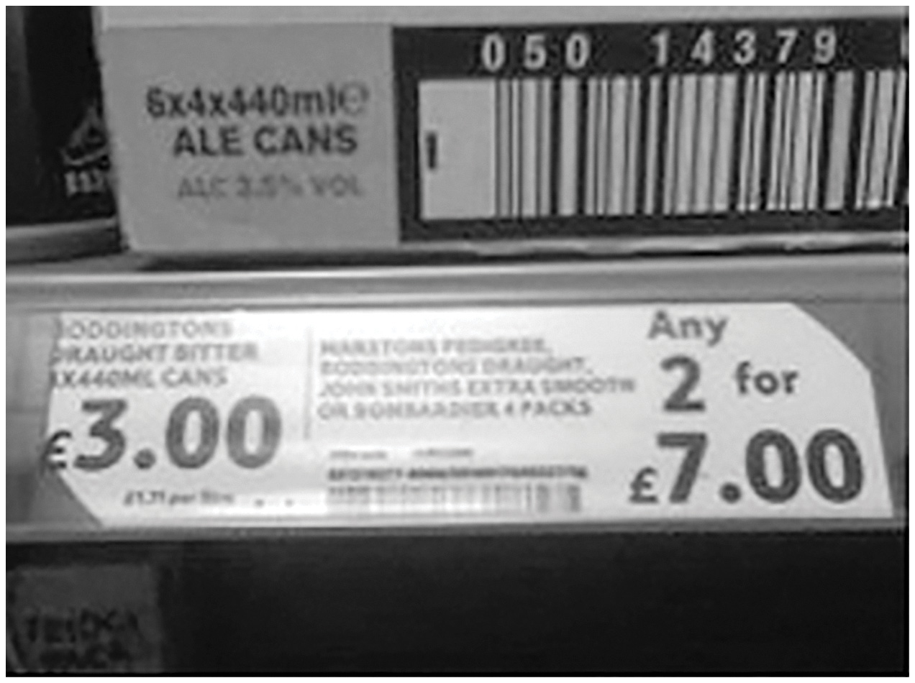
Price Discrimination Gone Wrong
What’s wrong in this picture?
Notes:
Real-world example: Price Discrimination Gone Wrong (See Tip #397)
[Wayne Geerling]

Slide 10
Economics in Minority Report
The future of advertising.
Notes:
“Economics in the Media” Slide
Lecture tip:
The clip mentioned on the slide can be found in the Interactive Instructor’s Guide. Access the direct link by clicking the icon in the PowerPoint above.
This is a nice, short clip that illustrates how firms will be able to sort consumers. The key concepts covered in this clip are:
Price discrimination
Advertising

Slide 11
Conditions of Price Discrimination
What two conditions must be met for price discrimination to be successful?
  Firm must be able to distinguish groups of buyers with different price elasticities of demand (different willingness to pay).
  Firm must prevent resale of the good or service.
Notes:
Lecture tip:
Ask students whether firms in a perfectly competitive market can charge discriminatory prices.
This implies that a third condition necessary for price discrimination is that the firm must have some market power—it is a price maker and faces a downward-sloping demand curve.

Slide 12
Distinguishing Groups of Buyers
General pricing rule
  Charge higher price to relatively inelastic consumers: insensitive to price
  Charge lower price to relatively elastic consumers: sensitive to price
How do firms distinguish different groups?
  Easily observable characteristics
  Consumers identify themselves
  Consumers “self-select” into a group
Notes:
Lecture notes:
On self-selection:
A good test example could be:
Early bird specials capture retirees and families with children, who tend to be more price sensitive (elastic demands).
Disneyland used to offer different ride packages.
Cell phone companies offer many different plans.

Slide 13
Preventing Resale—1
Why does a firm have to be able to prevent resale?
Notes:
Lecture notes: The customer who buys at the low price could then resell it to the firm’s high-price customers.

Slide 14
Resale Example
Suppose your university sells a popular magazine publication called U Magazine.
The magazines are sold to everyone on campus, and the following signs are displayed:
U Magazine
Faculty Price
$2.00
U Magazine
Student Price
$1.00
Notes:
“Beyond the Book” Slide
Lecture tip:
After revealing the signs, ask students the following question:
What would an intelligent, entrepreneurial student do?
Point out:
The magazines can easily be resold.
Simple answer:
The student would buy many magazines at $1.00 and sell them all to faculty for $1.50. Doing this, he or she would earn a profit of $0.50 per magazine, and faculty would buy from him or her to save $0.50 on their purchase.
Slightly more complex answer:
The student may first have to estimate the faculty demand so he or she would know how many faculty would be willing to buy the magazines from him or her at the $1.50 price.
The student doesn’t want to buy too many magazines and be stuck with them.
Review the parts of the table on this slide before moving on to the next slide.
Lecture notes:
A price maker has some control over the price it charges.

Slide 15
Preventing Resale—2
Why does a firm have to be able to prevent resale?
How does a firm prevent resale?
  Airlines require photo IDs
  Time-stamped movie tickets
  Nontransferable warrantees
  Adulteration of the product
  Price discrimination with services rather than goods
Notes:
Lecture notes:
On warrantees:
Firms sell similar products (cell phones, for example) in different countries at different prices.
On adulteration:
Plastic molding: Producers sell to dentists at a high price and for industrial uses at a low price. To prevent resale, arsenic is added to industrial molding.
On services rather than goods:
Goods are tangibles and are often easier to resell than services. For example, you couldn’t resell haircuts or trips to the buffet, but you could, however, resell shirts, books, and furniture.
Funeral services are another example.
Here, you could also discuss vertical integration as a way to prevent resale.
ALCOA supplied high-price aluminum to the aircraft industry, and low-price aluminum to the wire industry.
By integrating with wire producers, ALOCA could prevent resale.

Slide 16
One Price versus
Price Discrimination—1
Perfect price discrimination
  Firm sells the same good or service at a unique price to every consumer.
  Ideally, the firm would charge a price equal to the consumer’s maximum willingness to pay.
  At car dealerships and jewelry stores
Notes:
Lecture notes:
Note that by selling the good at the consumer’s WTP, the firm is trying to extract all the consumer surplus.
On the example of car dealerships and jewelry stores:
The seller posts a high sticker price and bargains with the consumer over a discount off the sticker or final price.
By bargaining, the seller is able to get a better idea about how much you are willing to pay.
On car dealers:
If you look at discounts off list, men get higher (on average) discounts than women do; whites get higher discounts than non-whites do. This holds after controlling for the race and gender of the salesperson.
Is this price discrimination (given what you have discussed) or something else? This could make for an interesting class discussion.
Although not discussed in the textbook, you may want to mention other classes of price discrimination. For example:
Perfect (first-degree) price discrimination
Second-degree price discrimination
Third-degree price discrimination

Slide 17
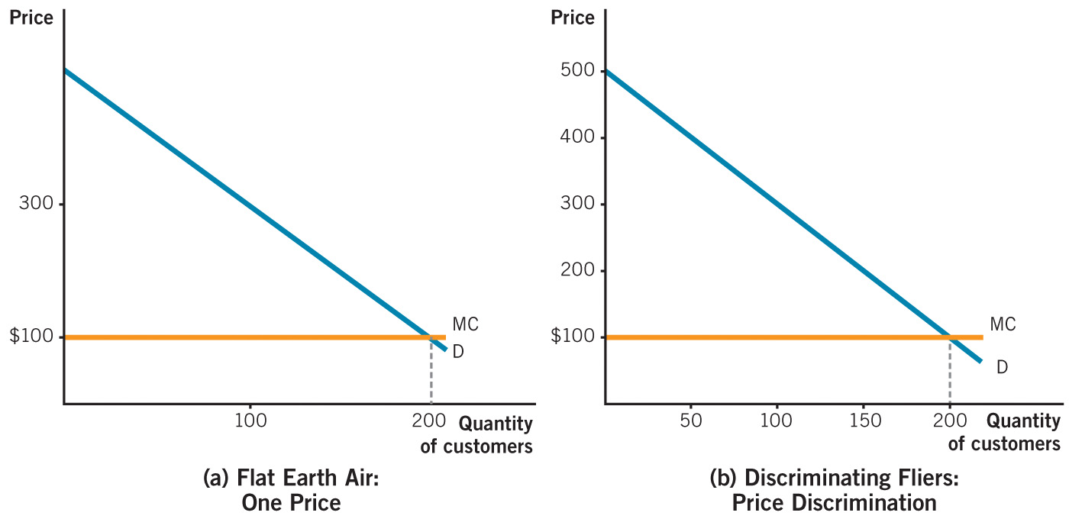
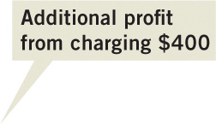
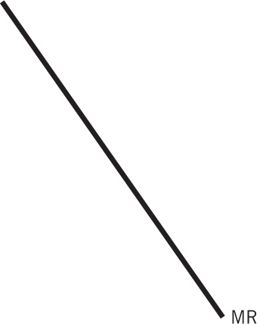
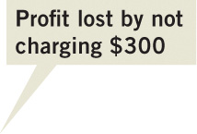


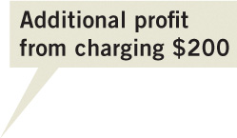


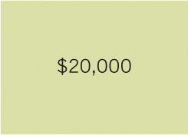

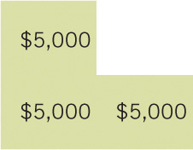


One Price versus
Price Discrimination—2
Notes:
Image: Animated Figure 11.1
Lecture notes:
The story behind the graphs:
Suppose there are two monopoly airlines: Flat Earth, who charges only one price, and Discriminating Fliers, who will charge its passenger two different prices.
Let’s see how they do this. They each fly a plane that can hold 200 passengers.
Flat Earth Air (left graph):
Ask students how they would determine the profit-maximizing output and price.
First click:
Draws the MR curve and the solution: Q* = 100, and P* = $300.
Ask students how much profit the firm earns.
Second click:
Shades profit box = ($300 - $100) x 100 = $20,000.
Discriminating Fliers (DF):
Third click:
Plots the one-price solution.
Note that if DF charged the same price ($300), they would be left with 100 empty seats.
Notice that we don’t draw a MR curve on the right. We don’t have the simple MR curve derived from the demand function when we price discriminate.
Suppose DF decides to charge two prices:
$400 for midweek flights or last-minute bookings. The airline saves 50 seats for the last-minute bookings (e.g., someone needing to travel to an impromptu business client meeting). These travelers have relative inelastic demands.
$200 for weekend flights and for customers who book in advance. These travelers have relatively elastic demands.
Fourth click:
Plots $400 price for a Q = 50.
Fifth click:
Plots $200 price for Q = 150.
Make sure students understand that overall they sell 150 tickets: 50 at $400 and 100 at $200.
Revenue and Profit Implications:
Sixth click:
Shades in profit from the first 50 tickets at $400.
If the firm charged only $300, they would have earned $10,000 in profit.
Since they charged $400, they earned an additional $5,000.
Seventh click:
Shades in additional revenue (profit) from being able to sell 150 tickets at $200.
Eight click:
Shaded in loss in revenue (profit) from not charging $300.
Overall, they gain an additional $5,000 in profit compared to Flat Earth Air.
Note that this figure will be confusing to many students since the profit boxes overlap each other.
An easy way to calculate profit:
50 tickets at $400: Profit = ($400 - $100) x 50 = $15,000
100 tickets at $200: Profit = ($200 - $100) x 100 = $10,000
Total profit = $25,000

Slide 18
Airline Itinerary Prices
Purchase Date | Itinerary Price | Example of Traveler
3 months before flight | $300 | Couple planning vacation; able to choose cheapest departure day
2 weeks before flight | $550 | Job interview candidate
2 days before flight | $750 | Businessperson, meeting with client during week; company paid for flight
Standby ticket, purchased at any time | $120 | Price-sensitive person with desire to travel and flexible schedule; undergrad during summertime
Notes:
“Beyond the Book” Slide
Consider the table on the slide. One of the reasons for price differences on airline fares is due to when the fare was purchased.
Questions for students:
Why does the price rise as the day of the flight draws closer?
Flights booked far ahead of time could be considered the “discounted” price. People who book that far ahead of time are probably booking a vacation and exact days may not matter, so they will look for the cheapest days to depart and return. People that book flights closer to the departure date tend to have less advanced notice about the trip they are taking, and they are usually more desperate (price inelastic) to take the flight for various reasons (job interview, business meeting, etc.). This means the airline can charge that customer a higher price.
Given this table, why doesn’t everyone just fly standby?
A standby ticket, while cheap, doesn’t guarantee a seat. Standby tickets are only useful if the plane has empty seats on a flight. Many people aren’t flexible enough with their schedules to go to the airport and have a window of eight or more hours to wait for a potential empty seat on a plane.

Slide 19
The Welfare Effects of Price Discrimination
Producers
  Have higher PS
  Firms make a higher profit
Consumers
  Benefit from more units being offered for sale, and more trading occurs
  Certain cases have higher overall CS
Overall
  Welfare increases and DWL decreases
Notes:
Lecture tip: Remind students what exactly Consumer Surplus and Producer Surplus are, and that the term “welfare” in this case is an overall benefit to society.

Slide 20
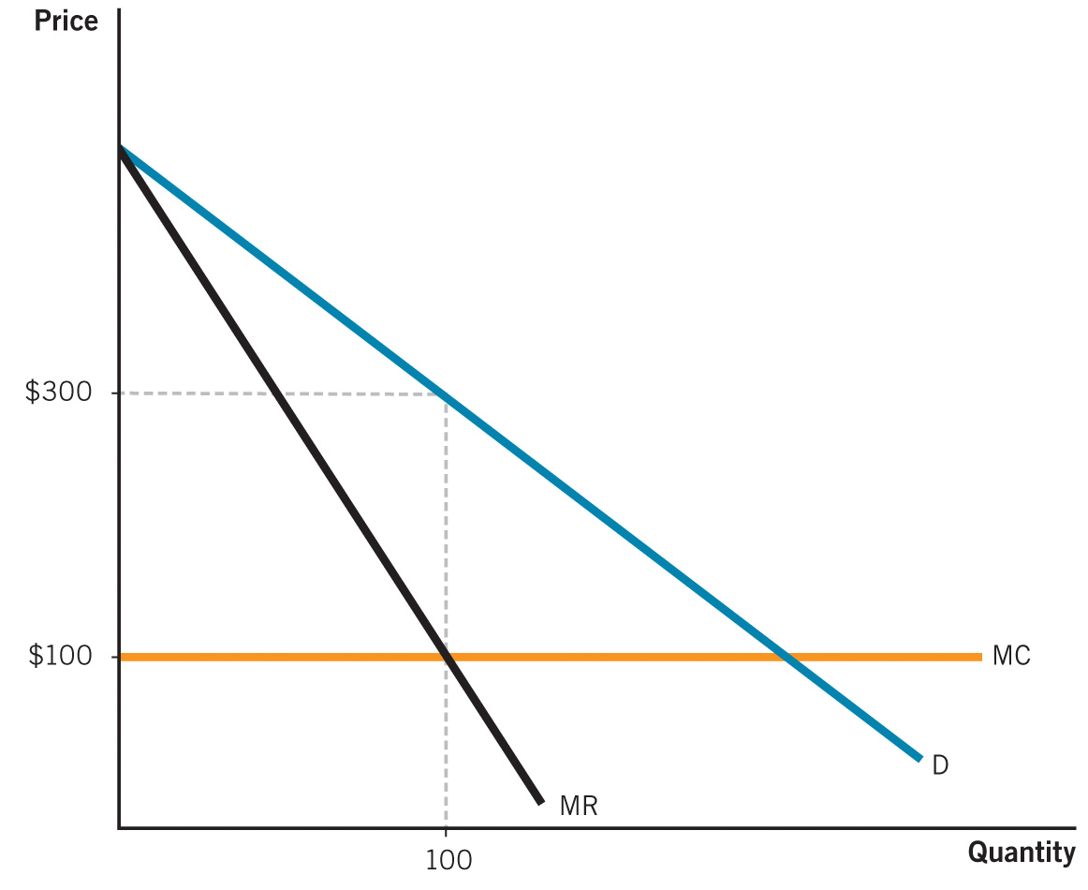
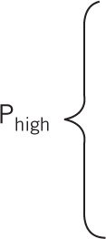
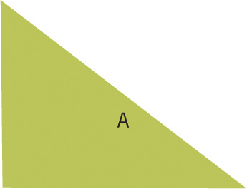
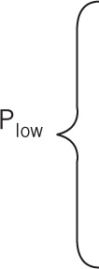


Perfect Price Discrimination
Notes:
Image: Animated Figure 11.2
Lecture notes:
The figure starts with a one-price solution.
First click:
Area B appears.
This represents profit earned by single price monopolist.
Second click:
Area A appears.
This represents additional profit earned by charging prices higher than $300.
Note that the firm charges each consumer their WTP.
Third click:
Area C appears.
This represents additional profit earned by charging lower than $300.
Note that the firm is still charging each firm a price equal to their WTP.
There are two results worth noting here:
200 flights is the same as would occur under perfect competition in which the price of all flights is equal to MC = 100.
200 flights is the same as would occur if the government regulated the airline and used the marginal cost pricing rule.

Slide 21
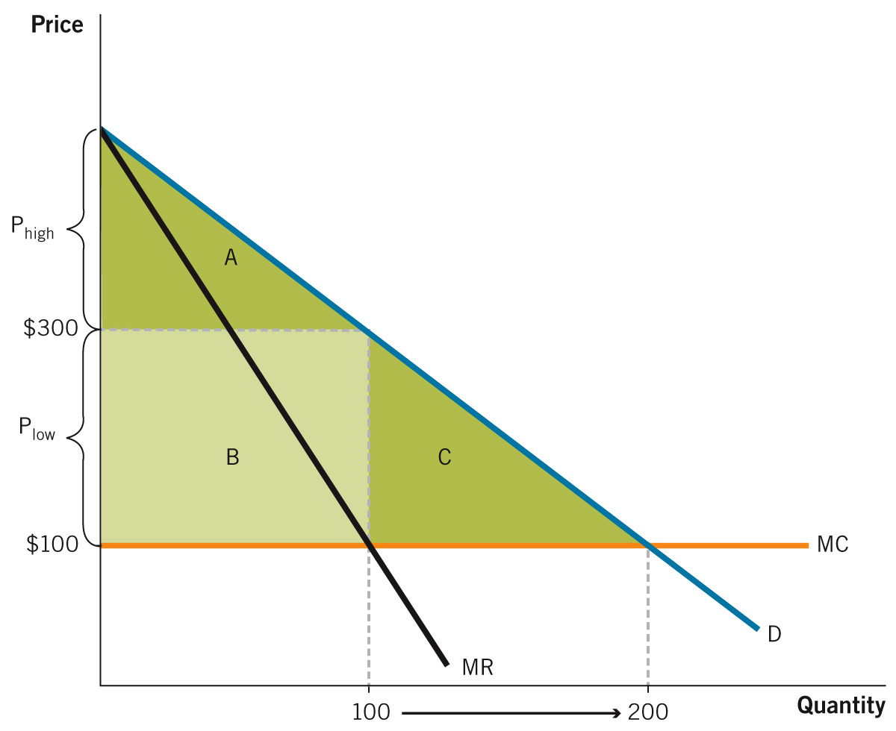
Comparing Market Structures
 | Perfect Competition | Single Price Monopoly | Perfect Price Discrimination
Consumer Surplus
Producer Surplus
Deadweight Loss
Total Welfare
A + B + C
A
A + B + C
0
B
0
0
C
0
A + B + C
A + B
A + B + C
Notes:
Image: Figure 11.2
Lecture tip:
Click to reveal each part of the table.
Before revealing, ask students what they think should appear in each row.
Perfect Competition:
1. What is CS under perfect price discrimination? A+B+C
2. What is PS under perfect price discrimination? 0
3. What is DWL under perfect price discrimination? 0
4. What is TW under perfect price discrimination? A+B+C
Monopoly:
1. What is CS under monopoly? A
2. What is PS under monopoly? B
3. What is DWL under monopoly? C
4. What is TW under monopoly? A+B
Perfect Price:
1. What is CS under perfect competition? A+B+C
2. What is PS under perfect competition? 0
3. What is DWL under perfect competition? 0
4. What is TW under perfect competition? A+B+C
Finally, ask students what they think economists mean by “perfect.”
Perfect means no DWL.
Social welfare is maximized; outcome is efficient, and so on.
Note that we are not making judgments about the distribution of the surplus.
From a pure welfare maximizing view, perfect competition and perfect price discrimination are equally good.

Slide 22
Practice What You Know—1
Which of the following goods or services is most likely to be sold successfully by a firm at different prices?
  economics textbooks
  haircuts
  candy bars
  university apparel
Notes:
Clicker question:
Correct answer: B, haircuts
The key here is arbitrage.
Books, candy bars, and clothing can all be easily resold.
A haircut is a service and can’t be resold.

Slide 23
Practice What You Know—2
Dirk buys chicken nuggets. Lee buys chicken parmesan. The two men pay two different prices for these goods. This is an example of
  demand shifting.
  inelastic demand.
  price discrimination.
  none of the above.
Notes:
Clicker question:
Correct answer: D, none of the above
While the goods are different in price, there are cost differences in their production. This is not price discrimination.

Slide 24
Practice What You Know—3
A general rule for price discriminating with two consumers groups is to charge a ______ price to the inelastic group and a ______ price to the elastic group.
  high; low
  low; high
  positive; negative
  negative; positive
Notes:
Clicker question:
Correct answer: A, high; low
You would charge the relatively higher price to the relative insensitive (inelastic) consumer group.

Slide 25
Practice What You Know—4
What market and pricing structure has the least amount of consumer surplus?
  perfect competition
  pure monopoly (single price)
  a price discriminating monopoly that charges two different prices
  a monopolist that engages in perfect price discrimination
Notes:
Clicker question:
Correct answer: D, a monopolist that engages in perfect price discrimination
Students should be careful when answering this question:
Just because perfect price discrimination has zero CS doesn’t mean it’s inefficient.
Perfect price discrimination is actually efficient in the sense that it has no DWL, but it is very inequitable since all the surplus goes to producers.

Slide 26
Practice What You Know—5
Why might one consumer group (A) have a more elastic demand (and be more price sensitive) than another group (B) of consumers?
  Group (A) may have less income.
  Group (A) may have lower tastes and preferences for the good.
  Both of the above could be true.
  None of the above.
Notes:
Clicker question:
Correct answer: C, Both of the above could be true.
A number of factors can affect an individual’s willingness to pay for a good.

Slide 27
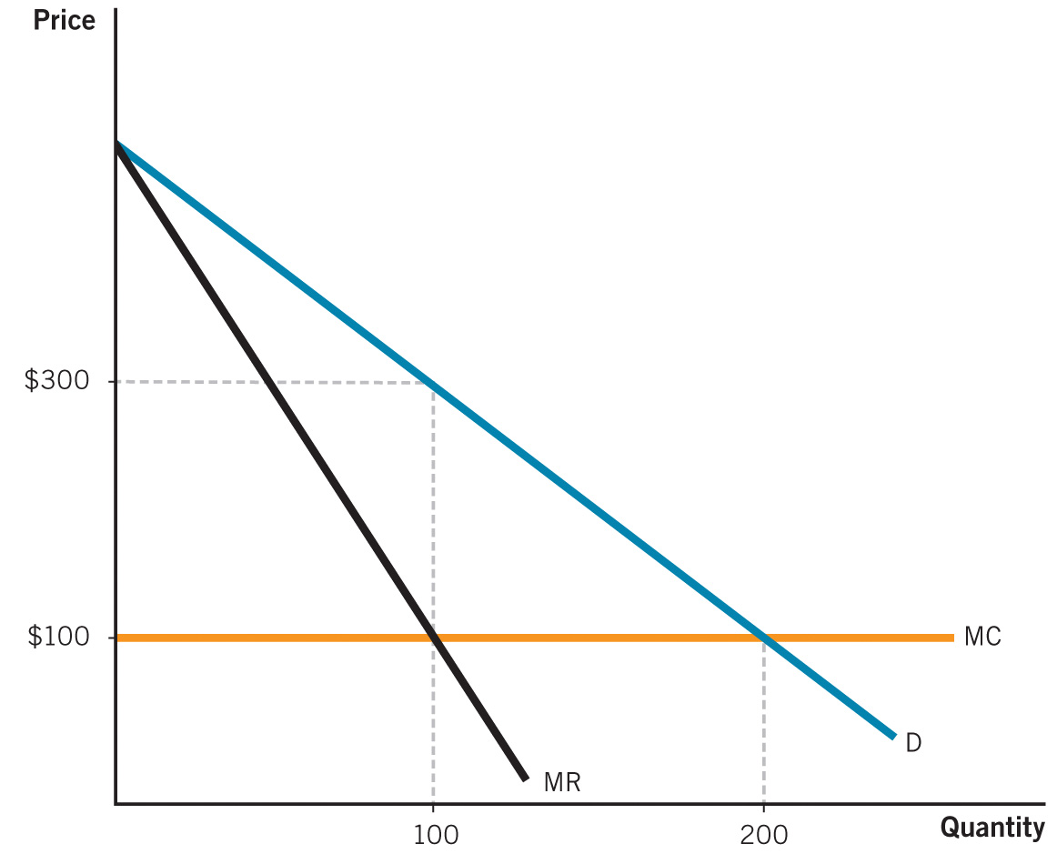
Class Activity: Think-Pair-Share: Welfare Analysis—1.A
Use the figure to the right to calculate consumer surplus, producer surplus, and total welfare under:
Perfect competition
Single price monopoly
Perfect price discrimination
Notes:
Classroom activity: Think-Pair-Share: Welfare Analysis
Ask students to get into pairs and solve the problem written out in the slide. Then, discuss in class.
The answer will be revealed on next slide.

Slide 28
Class Activity: Think-Pair-Share: Welfare Analysis—1.B
Perfect competition
CS = $40,000
PS = 0
TW = $40,000
2. Monopoly
CS = $10,000
PS = $20,000
TW = $30,000
Notes:
Classroom activity: Think-Pair-Share: Welfare Analysis
Lecture notes:
Perfect Competition:
Consumer surplus is the triangle below the demand curve and above the $100 price = marginal cost:
CS = ½ x ($500 - $400) x 200 = $40,000
Producer surplus is equal to zero since marginal cost is constant.
Total welfare = CS + PS = $0 + $40,000 = $40,000
Monopoly:
Consumer surplus is the triangle below the demand curve and above the monopoly price of $300.
CS = ½ x ($500 - $300) x 100 = $10,000
Producer surplus is the rectangle between the monopoly price and marginal cost.
PS = ($300 - $100) x 100 = $20,000
Total welfare = CS + PS = $10,000 + $20,000 = $30,000
Therefore, the deadweight loss is equal to $10,000.

Slide 29
Class Activity: Think-Pair-Share: Welfare Analysis—1.C
Price discrimination
CS = 0
PS = $40,000
TW = $40,000
Notes:
Classroom activity: Think-Pair-Share: Welfare Analysis
Lecture notes:
Consumer surplus is equal to zero since each consumer pays the maximum price he or she is willing to pay.
Producer surplus is the triangle below the demand curve and above marginal cost:
PS = ½ x ($500 - $400) x 200 = $40,000
Total welfare = CS + PS = $0 + $40,000 = $40,000
Note that this is the same total welfare under perfect competition.

Slide 30
Two-Part Tariffs and Discrimination—1
A two-part tariff includes:
  A per-unit price
  A fixed fee
Cell phone plans, electricity, and golf clubs
How does a golf club set a two-part tariff?
  Sets a per-unit price (greens fee)
  Sets a membership fee equal to the buyer’s consumer surplus at that price
Notes:
Lecture notes:
Two-part tariffs are an example of nonlinear pricing:
The average price per unit falls as more units are purchased.
Block pricing is another example of nonlinear pricing.
For 0–100 units, you pay $5.00 per unit.
For 101–200 units, you pay $3.00 per unit.
For > 200 units, you pay $1.00 per unit.
So as you buy more and more, the average price you pay goes down.
Optimal two-part tariff:
We are assuming that the firm knows the consumer’s demand curve.

Slide 31
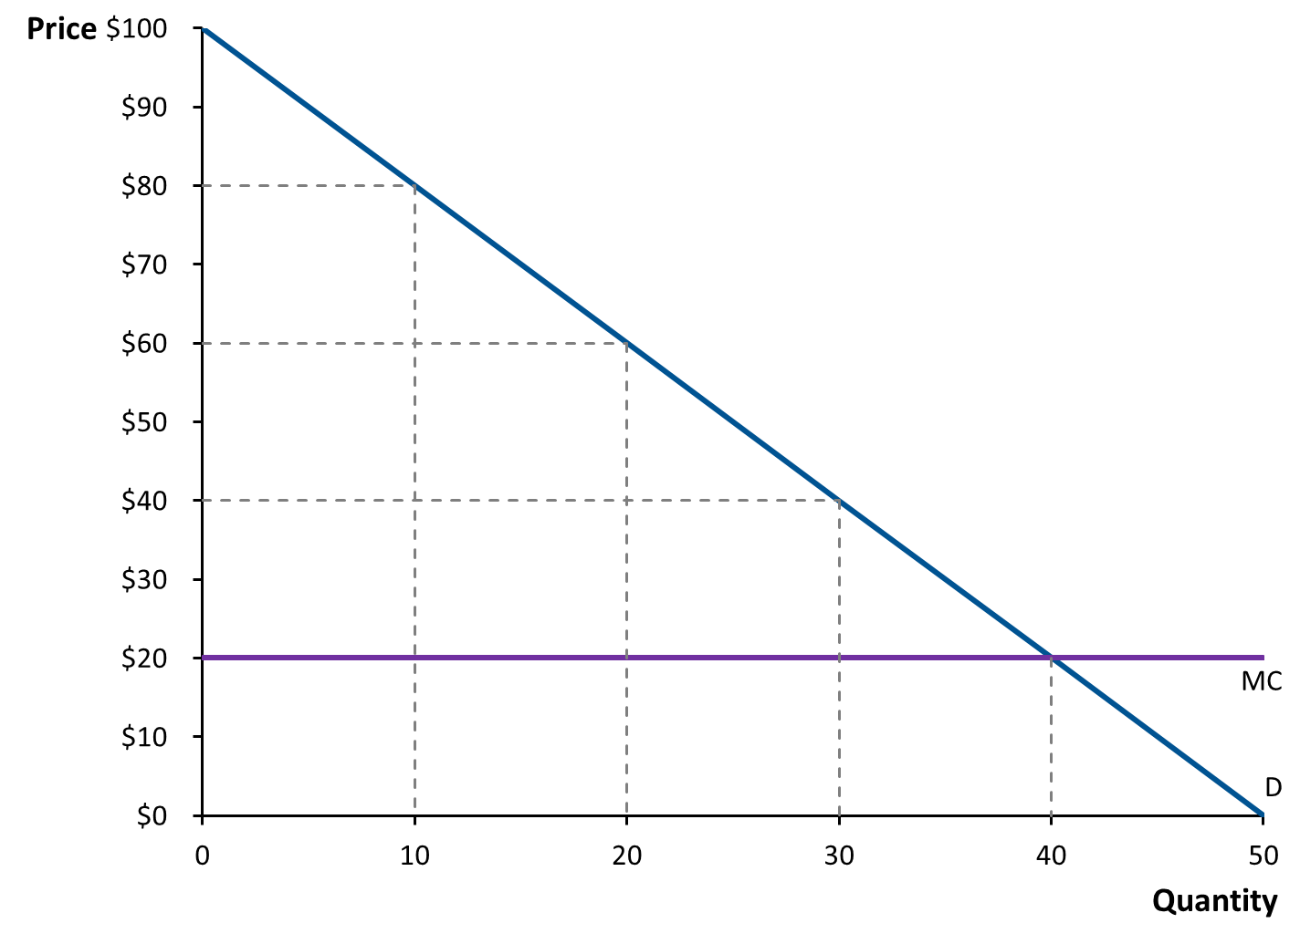
Two-Part Tariffs at a Golf Club: Per-Unit Price = $60
$400
$800
Notes:
Image: Animated Graph
Lecture notes:
The graph on the slide shows a typical golfer’s annual demand for rounds of golf. If greens fees are $80, she would play 10 rounds of golf. If greens fees are $40, she would play 30 rounds of golf.
Assume that the marginal cost for a round of golf is $20 (it’s a really fancy golf club so it includes a cart, someone to drive and clean your clubs, complementary beverages, etc.).
At a price of $60, she would play 20 rounds of golf.
First click:
Shades in profit box.
Without a fee, the club would make ($60 - $20) x 20 = $800.
Ask students what is the largest fee the club could charge if the price of a round of gold was $60.
Second click:
Shades in CS triangle above $60.
The fee = ½ x ($100 - $60) x 20 = $400.
Total profit = $1,200
Now ask students if there is a better per-unit price and fee combination.
As you cut the per-unit price (the greens fee) you lose profit, but you can increase the fee, which gains profit.

Slide 32
Two-Part Tariffs at a Golf Club: Per-Unit Price = $40
$900
$600
Notes:
Image: Animated Graph
Lecture notes:
First click:
Shades in profit box.
Profit = $600
Second click:
Shades in CS triangle.
CS = Fee = $900
Total profit = $1,500, a gain of $300

Slide 33
Two-Part Tariffs at a Golf Club: Per-Unit Price = MC = $20
$1,600
Notes:
Image: Animated Graph
Lecture notes:
First click:
Shades in CS triangle.
CS = Fee = $1,600
Total profit = $1,600

Slide 34
Two-Part Tariffs and Discrimination—2
How does a golf club set a two-part tariff?
  Sets a per-unit price (greens fee)
  Sets a membership fee equal to the buyer’s consumer surplus at that price
  So the tariff that maximizes profits is one where:
    Price = MC
    Fee = Consumer surplus at that price
Notes:
Lecture notes:
Outcome is the same as under perfect price discrimination.
Total welfare is maximized so no DWL.
In reality:
Club does not know a golfer’s demand curve.
But it can set multiple two-part tariffs and let the golfers decide which is best for them.

Slide 35
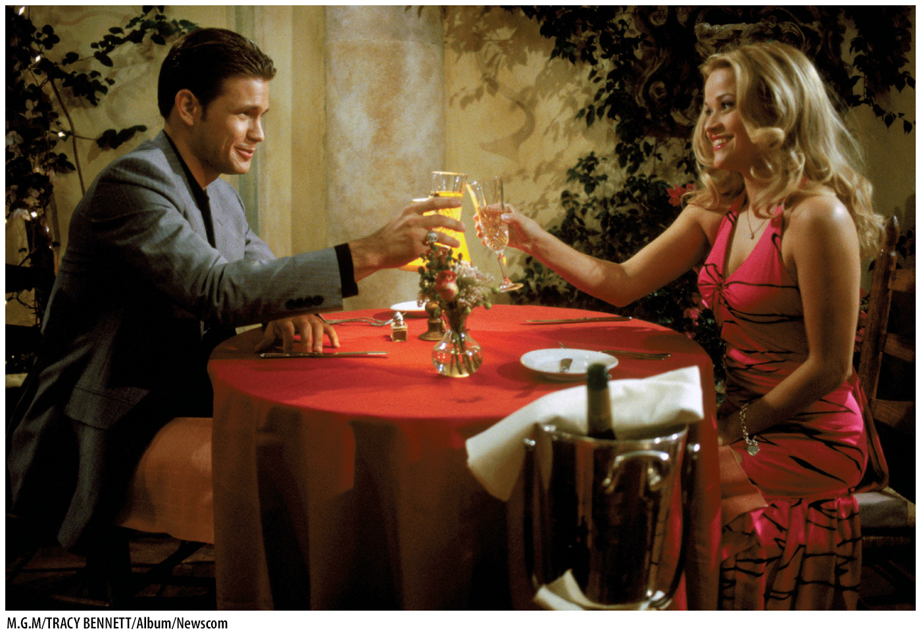
Economics in Legally Blonde
The salesperson can’t fool this sun-washed sorority girl, Elle Woods.
Notes:
“Economics in the Media” Slide
Lecture tip:
The clip mentioned on the slide can be found in the Interactive Instructor’s Guide. Access the direct link by clicking the icon in the PowerPoint above.
This scene provides a nice example of an attempt at price discrimination. You could follow up the clip by starting an in-class discussion on how sellers attempt to price discriminate.
Ask students the following questions:
What clues decide how much a buyer is willing to pay? How elastic or inelastic is their demand curve?
[M.G.M / TRACY BENNETT / Album/Newscom]

Slide 36
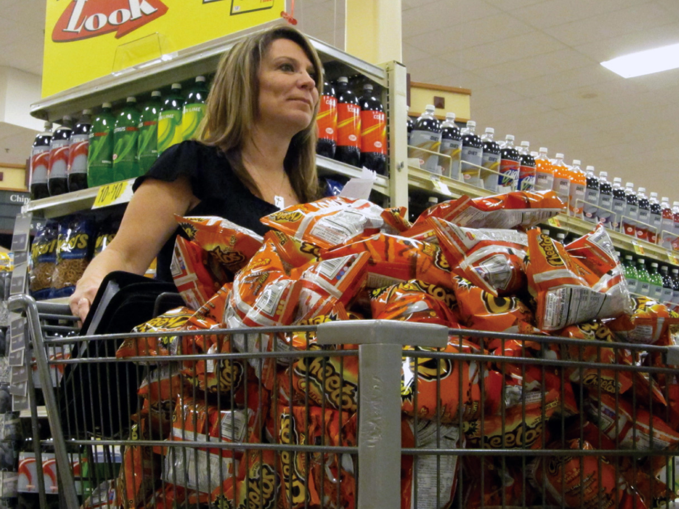
Economics in Extreme Couponing, “Joyce’s Checkout”
Joyce saves $200 at the store, but it takes a lot of work.
Notes:
“Economics in the Media” Slide
Lecture tip:
The clip mentioned on the slide can be found in the Interactive Instructor’s Guide. Access the direct link by clicking the icon in the PowerPoint above.
This scene provides a nice example of an attempt at price discrimination. You can relate this clip to opportunity cost of time (“Is it really worth it?”).
[© TLC/Courtesy of Everett Collection/Everett Collection]

Slide 37
Price Discrimination at the Movies—1
What are some ways movie theaters practice price discrimination?
Time of the show
  Matinee prices less than evening shows
  Lower prices attract consumers who have more elastic demands—more price sensitive
  Low variable cost to being open during day
Notes:
Lecture tip:
See if students can list all the ways before you discuss them:
Time of show
Age/student status
Concession pricing
What “type” of people attend matinees?
Retirees, people on vacation, and those who do not work during the day
On variable cost:
Relatively few employees at low wages.
Theaters can earn revenue over variable costs, which add to profits.

Slide 38
Price Discrimination at the Movies—2
Age or student status
  Can income explain the pattern of discounts?
  Movie attendance highest for 13–24-year-olds, and declines with age.
  Child discounts stop around 12; senior discounts start around 50
Notes:
Lecture notes:
It makes sense that child discounts end at 12, since the demand by teenagers/young adults high.
Even though “senior” citizens in their 50s have higher incomes, their demand is relatively low, so discounts give them more incentive to attend a movie.
A minor point to make:
Age-based discrimination may not work perfectly since it is difficult to tell how old someone is and may be bad for business to check someone’s ID.

Slide 39
Price Discrimination at the Movies—3
Concession pricing
  Price inelastic consumers
    Will eat theater snacks; willing to pay high price
  Price elastic consumers
    Will not eat theater snacks or will smuggle in their own food
  Which customers does the theater want?
    It wants both of them in the seats watching the movie. Empty seats are lost revenue.
Notes:
Lecture tip:
This is really a far more complex problem than discussed here. You may want to also discuss that the movie theater is setting two prices at once: one for the movie ticket and one for concessions.

Slide 40
Price Discrimination on Campus—1
Tuition
  FAFSA lowers tuition costs for qualifying students.
  In-state students pay less tuition than out-of-state students.
    What does that imply about their respective elasticities of demand?
  Private colleges have high stickers, which they can discount.
Notes:
Lecture notes:
FAFSA = Free Application for Federal Student Aid.
This separates college students based on income.
In-state versus out-of-state:
Out-of-state students pay more for two reasons:
Parents haven’t been paying taxes in this state to support the university (assuming it’s a public university).
If you are willing to go out of state, you must really value this university over others and are willing to pay more for it.
Out-of-state students have a more inelastic demand.
Private schools:
Discounts can be offered to lower-income students and/or encourage particular students to attend.

Slide 41
Price Discrimination on Campus—2
Student discounts
  Local bars, restaurants, shops, etc.
  Why offer students discounts?
    Students often have lower incomes and are much more price sensitive—more elastic demand.
Notes:
Lecture notes:
How are these student discounts enforced?
Most of the time, vendors will ask to see a student ID before applying a discount.
More-advanced student IDs can contain digital personal information and even act as a debit card. If a student pays for the goods or services with an ID, a discount is automatically applied.

Slide 42
Practice What You Know: Price Discrimination Quiz
Look at each of the following situations. Are they examples of price discrimination?
  Yes: cheer
  No: boo
Notes:
Lecture tip:
For this in-class activity, read each situation out loud, and then have the students cheer or boo on your command.

Slide 43
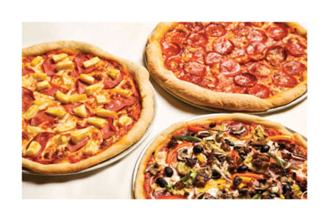
Practice What You Know: Price Discrimination Quiz—1
At Little Nero’s Pizza, the menu lists the following prices:
  Cheese pizza = $8
  Supreme pizza = $11
Price discrimination?
  Yes: cheer
  No: boo
Answer: NOT price discrimination
The price differences exist in part due to cost of production differences.
Notes:
Clicker question:
Correct answer: NOT price discrimination
[Radius Images / Alamy]

Slide 44
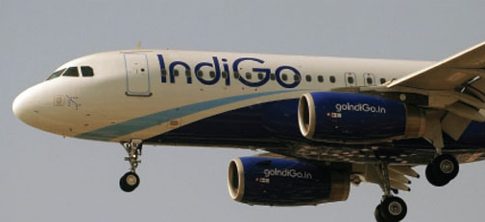
Practice What You Know: Price Discrimination Quiz—2
Lee buys an economy-class airline ticket for $100, and Dirk buys a first-class ticket for $200.
Price discrimination?
  Yes: cheer
  No: boo
NOT price discrimination
Dirk may get extra drinks and food, which are additional costs to the airline.
Notes:
Clicker question:
Correct answer: NOT price discrimination
[AFP/Getty Images/Newscom]

Slide 45
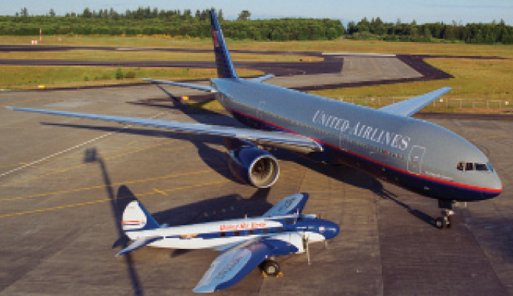
Practice What You Know: Price Discrimination Quiz—3
Lee and Dirk both buy economy-class tickets on the same flight. Lee pays $83 less than Dirk because he booked two weeks earlier.
Price discrimination?
  Yes: cheer
  No: boo
YES, price discrimination
The product is the same, and the price difference has nothing to do with cost differences.
Notes:
Clicker question:
Correct answer: Price discrimination
[© Chmiel/iStockphot.com]

Slide 46

Practice What You Know: Price Discrimination Quiz—4
Jaime gets her oil changed at Cars ’N Stuff for $30, and Katie gets her oil changed at Automotives Incorporated for $25.
Price discrimination?
  Yes: cheer
  No: boo
NOT price discrimination
Two firms are offering different products; there may be quality and cost differences.
Notes:
Clicker question:
Correct answer: NOT price discrimination

Slide 47
Practice What You Know: Price Discrimination Quiz—5
Joe and Sheila each buy tickets to the ballet and sit together. Joe paid $5 less than Sheila did because of a student discount.
Price discrimination?
  Yes: cheer
  No: boo
YES, price discrimination
The product is the same, and the price difference has nothing to do with cost differences.
Notes:
Clicker question:
Correct answer: Price discrimination

Slide 48
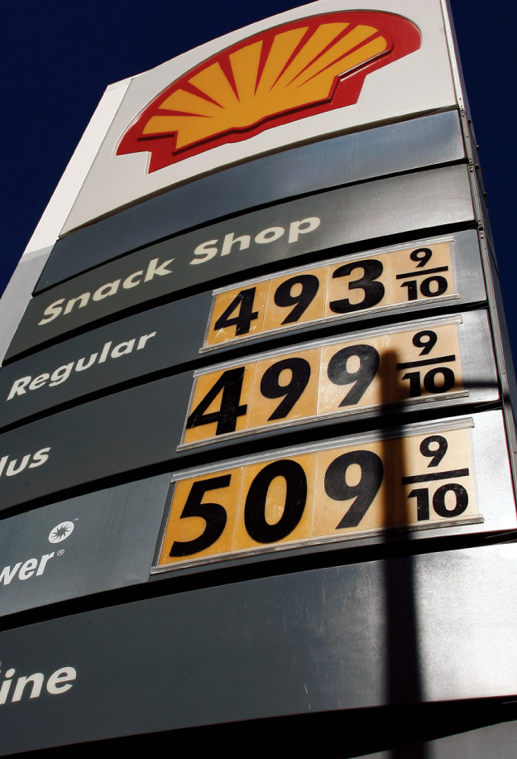
Practice What You Know: Price Discrimination Quiz—6
Lincoln, Nebraska, gas price = $3.49
Austin, Texas, gas price = $3.79
Price discrimination?
  Yes: cheer
  No: boo
NOT price discrimination
Cost may be higher to get gas to Austin. In addition, two different firms are selling the product.
Notes:
Clicker question:
Correct answer: NOT price discrimination
[AP Photo/Reed Saxon, File]

Slide 49
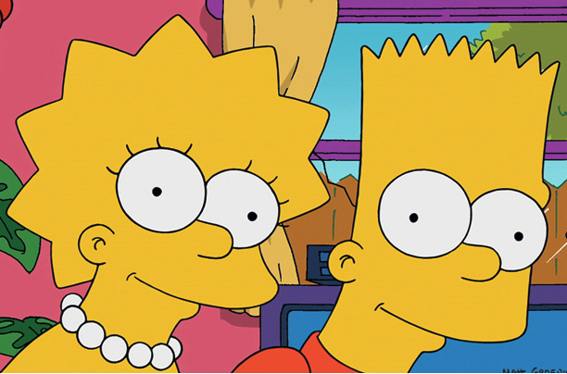
Practice What You Know: Price Discrimination Quiz—7
Bart and Lisa go to a club. Bart has to pay a cover charge for entry, but Lisa gets in for free due to a “Ladies’ Night” special.
Price discrimination?
  Yes: cheer
  No: boo
YES, price discrimination
The product is the same, and the price difference has nothing to do with cost differences.
Notes:
Clicker question:
Correct answer: Price discrimination
[©20th Century Fox. All rights reserved/courtesy Everett Collection]

Slide 50
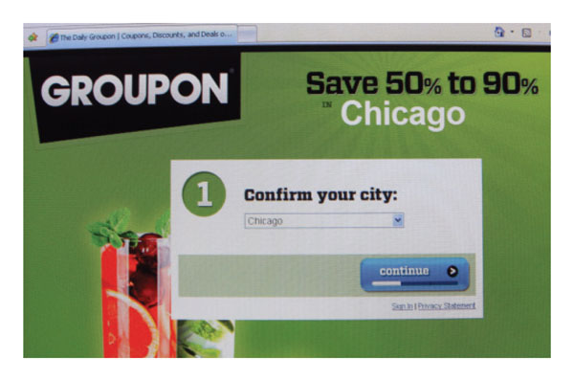
Practice What You Know: Price Discrimination Quiz—8
Mark and JoAnn each buy one box of cereal at the local grocery store. JoAnn gets a $1.00 discount by using a coupon.
Price discrimination?
  Yes: cheer
  No: boo
YES, price discrimination
The product is the same, and the price difference has nothing to do with cost differences.
Notes:
Clicker question:
Correct answer: Price discrimination
JoAnn has revealed her sensitivity to price by searching for a coupon and waiting to buy the cereal until a coupon is available.
[Scott Olson/Getty Images]

Slide 51
Conclusion
Price discrimination helps us see how many markets function since instances of perfect competition and monopoly are rare.
Price discrimination general rule:
  Charge higher price to relatively inelastic consumer group
  Charge lower price to relatively elastic group
Results of price discrimination
  Increasing social welfare
  Decreasing deadweight loss
  Creates a more efficient outcome
Notes:
Lecture notes:
Recall some often-seen examples of price discrimination at the end of the lecture:
Student discounts
Military discounts
Senior citizen discounts
Movie matinees
Airline tickets
You can also reiterate the following points:
A firm must have some market power before it can charge more than one price.
Price discrimination occurs when:
Firms have downward-sloping demand curves.
Firms can identify different groups of customers with varying price elasticities.
Firms have the ability to prevent resale among their customers.
Under price discrimination:
Some consumers pay a higher price.
Others are given a discount.
Price discrimination
Is profitable for the firm
Reduces deadweight loss
Helps to restore a higher output level
While “discrimination” often has a negative connotation, price discrimination is actually good in the sense that it improves overall economic welfare. This is due to the reduction of deadweight loss and the increased number of trades resulting from charging different prices.

